Slide 1
2. Software Development Process
The specifics of what these people do, how they interact, and how they make decisions are all part of the software development process.

Slide 2
2. The Software Development Process
What major components go into a software product
What different people and skills contribute to a software product
How software progresses from an idea to a final product

Slide 3
Product Components
What Effort Goes Into a Software Product?
What Parts Make Up a Software Product?

Slide 4
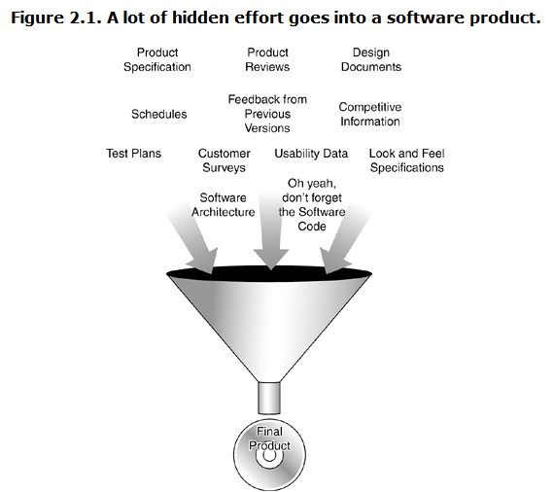
What Effort Goes Into a Software Product?

Slide 5
●Customer Requirements
■To properly fill that need, the product development team must find out what the customer wants.
■ Some teams simply guess
■ Most collect detailed information in the form of surveys, feedback from previous versions of the software,
----competitive product information,
----magazine reviews,
----focus groups,
-----and numerous other methods, some formal, some not.

Slide 6
●Customer Requirements
■All this information is then studied, condensed, and interpreted
■ To decide exactly what features the software product should have.

Slide 7
● Specifications
■ The result of the customer requirements studies is really just raw data.
■ It doesn't describe the proposed product, it just confirms whether it should (or shouldn't) be created and what features the customers want.
■ The specifications take all this information plus any unstated but mandatory requirements and truly define what the product will be, what it will do, and how it will look.
■ The format of specifications varies greatly.

Slide 8
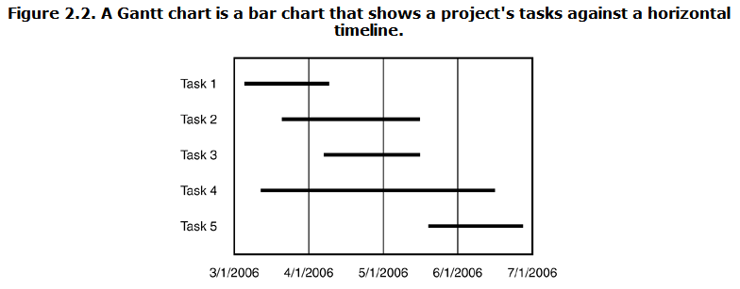
● scheduling
The goals of scheduling are to know which work has been completed, how much work is still left to do, and when it will all be finished.

Slide 9
Software Design Documents
● Architecture
● Data Flow Diagram
● State Transition Diagram
● Flowchart
● Commented Code

Slide 10
Test Documents
● test plan
● Test cases
● Bug reports
● Test tools and automation
● Metrics, statistics, and summaries

Slide 11
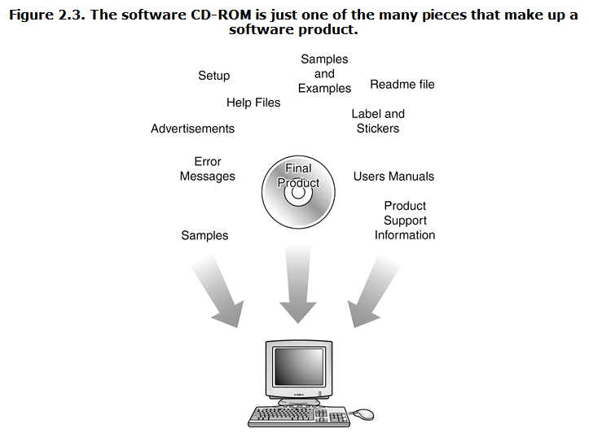
What Parts Make Up a Software Product?

Slide 12
What Parts Make Up a Software Product?
● It's also important to realize that when the product is ready to be boxed up and shipped out the door, it's not just the code that gets delivered.
● Numerous supporting parts go along with it.
● Since all these parts are seen or used by the customer, they need to be tested too.

Slide 13
Help files | User's manual
Samples and examples | Labels and stickers
Product support info | Icons and art
Error messages | Ads and marketing material
Setup and installation | Readme file

Slide 14
DON'T FORGET TO TEST ERROR MESSAGES
Error: Keyboard not found. Press F1 to continue.
Can't instantiate the video thing. Windows has found an unknown device and is installing a driver for it.
A Fatal Exception 006 has occurred at 0000:0000007.

Slide 15
Software Project Staff
Project managers, program managers, or producers
Architects or system engineers
Programmers, developers, or coders
Testers or QA (Quality Assurance) Staff
Technical writers, user assistance, user education, manual writers, or illustrators
Configuration management or builder

Slide 16
Software Development Lifecycle Models
Big-Bang
Code-and-Fix
Waterfall
Spiral

Slide 17
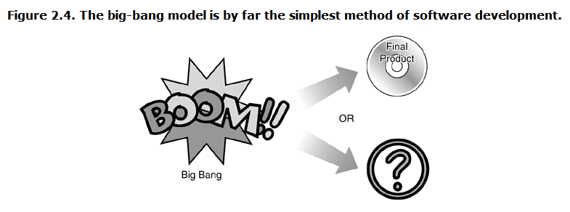
Software Development Lifecycle Models
Big-Bang

Slide 18
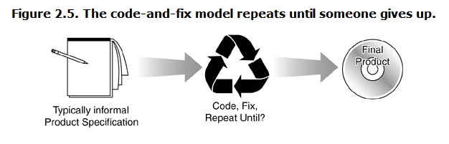
Software Development Lifecycle Models
Code-and-Fix

Slide 19
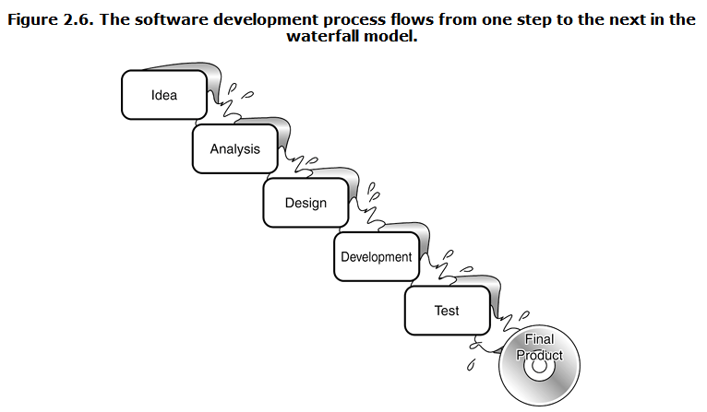
Software Development Lifecycle Models
Waterfall

Slide 20
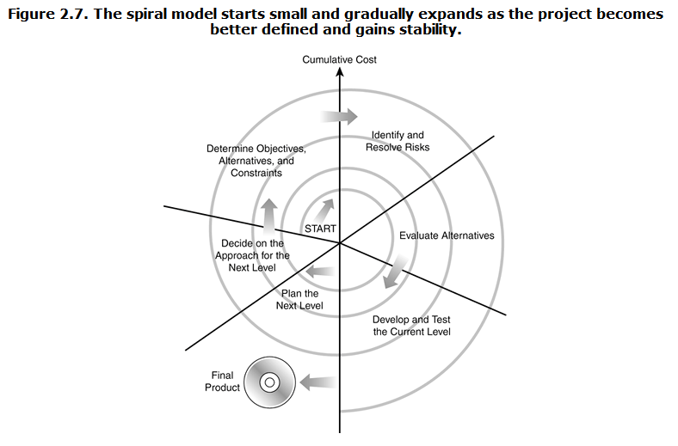
Software Development Lifecycle Models
Spiral

Slide 21
AGILE SOFTWARE DEVELOPMENT
Test-Driven Development，TDD

Slide 22
Test-Driven Development，TDD
Test-Driven Development (TDD) is an approach to software design that is rooted in challenges to the production code to proceed in baby steps to build up functionality.
This can feel counterintuitive to people who are just starting to learn, but it offers some advantages, including cleaner development.

Slide 23
Test-Driven Development，TDD
It can also be faster to use this method once people are accustomed to it, depending on the nature of the project.
Programmers can use a wide variety of programming languages in test-driven development, and may apply it to new software, version improvements, or fixes to existing programs.

Slide 24
Software Testing Model

Slide 25
"V" Model
V Model is an enhanced version of the classic waterfall model whereby each level of the development life-cycle is verified before moving on to the next level.
With this model, software testing explicitly starts at the very beginning, i.e. as soon as the requirements are written.
https://www.testingexcellence.com/v-model-in-software-testing/

Slide 26
"W" Model
In a W-Model, each stage must be finished completely before the following stage can start.

Slide 27
W模型
测试伴随着整个软件开发周期
测试的对象不仅仅是程序，需求、设计和功能同样要测试
根据W模型的要求，一旦有文档提供，就要及时确定测试的条件、编写测试用例

Slide 28
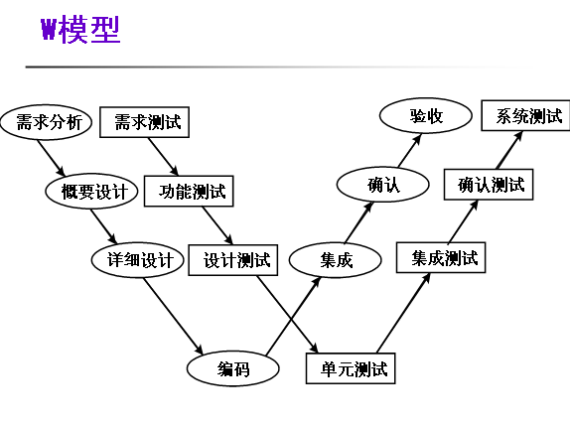

Slide 29
H模型
软件测试不仅仅指测试的执行，还包括很多其他的活动。
软件测试是一个独立的流程，贯穿产品整个生命周期，与其他流程并发的进行。
软件测试要尽早准备，尽早执行。
软件测试是根据被测物的不同而分层进行的。不同层次的测试活动可以按照某个次序先后进行的，但也可能是反复的。

Slide 30
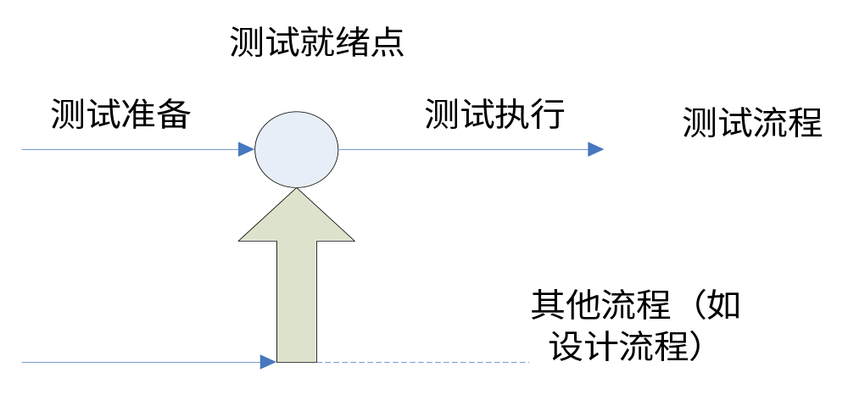
H模型
这个示意图仅仅演示了在整个生产周期中某个层次上的一次测试“微循环”。图中的其他流程可以是任意开发流程。

Slide 31
X模型
X模型提出针对单独的程序片段进行相互分离的编码和测试,此后通过频繁的交接,通过集成最终合成为可执行的程序。
己通过集成测试的成品可以进行封装并提交给用户，也可以作为更大规模和范围内集成的一部分。
多根并行的曲线表示变更可以在各个部分发生。

Slide 32
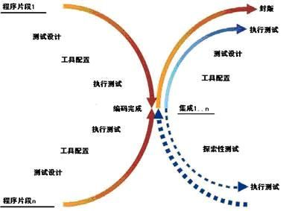
X模型

